Slide 1
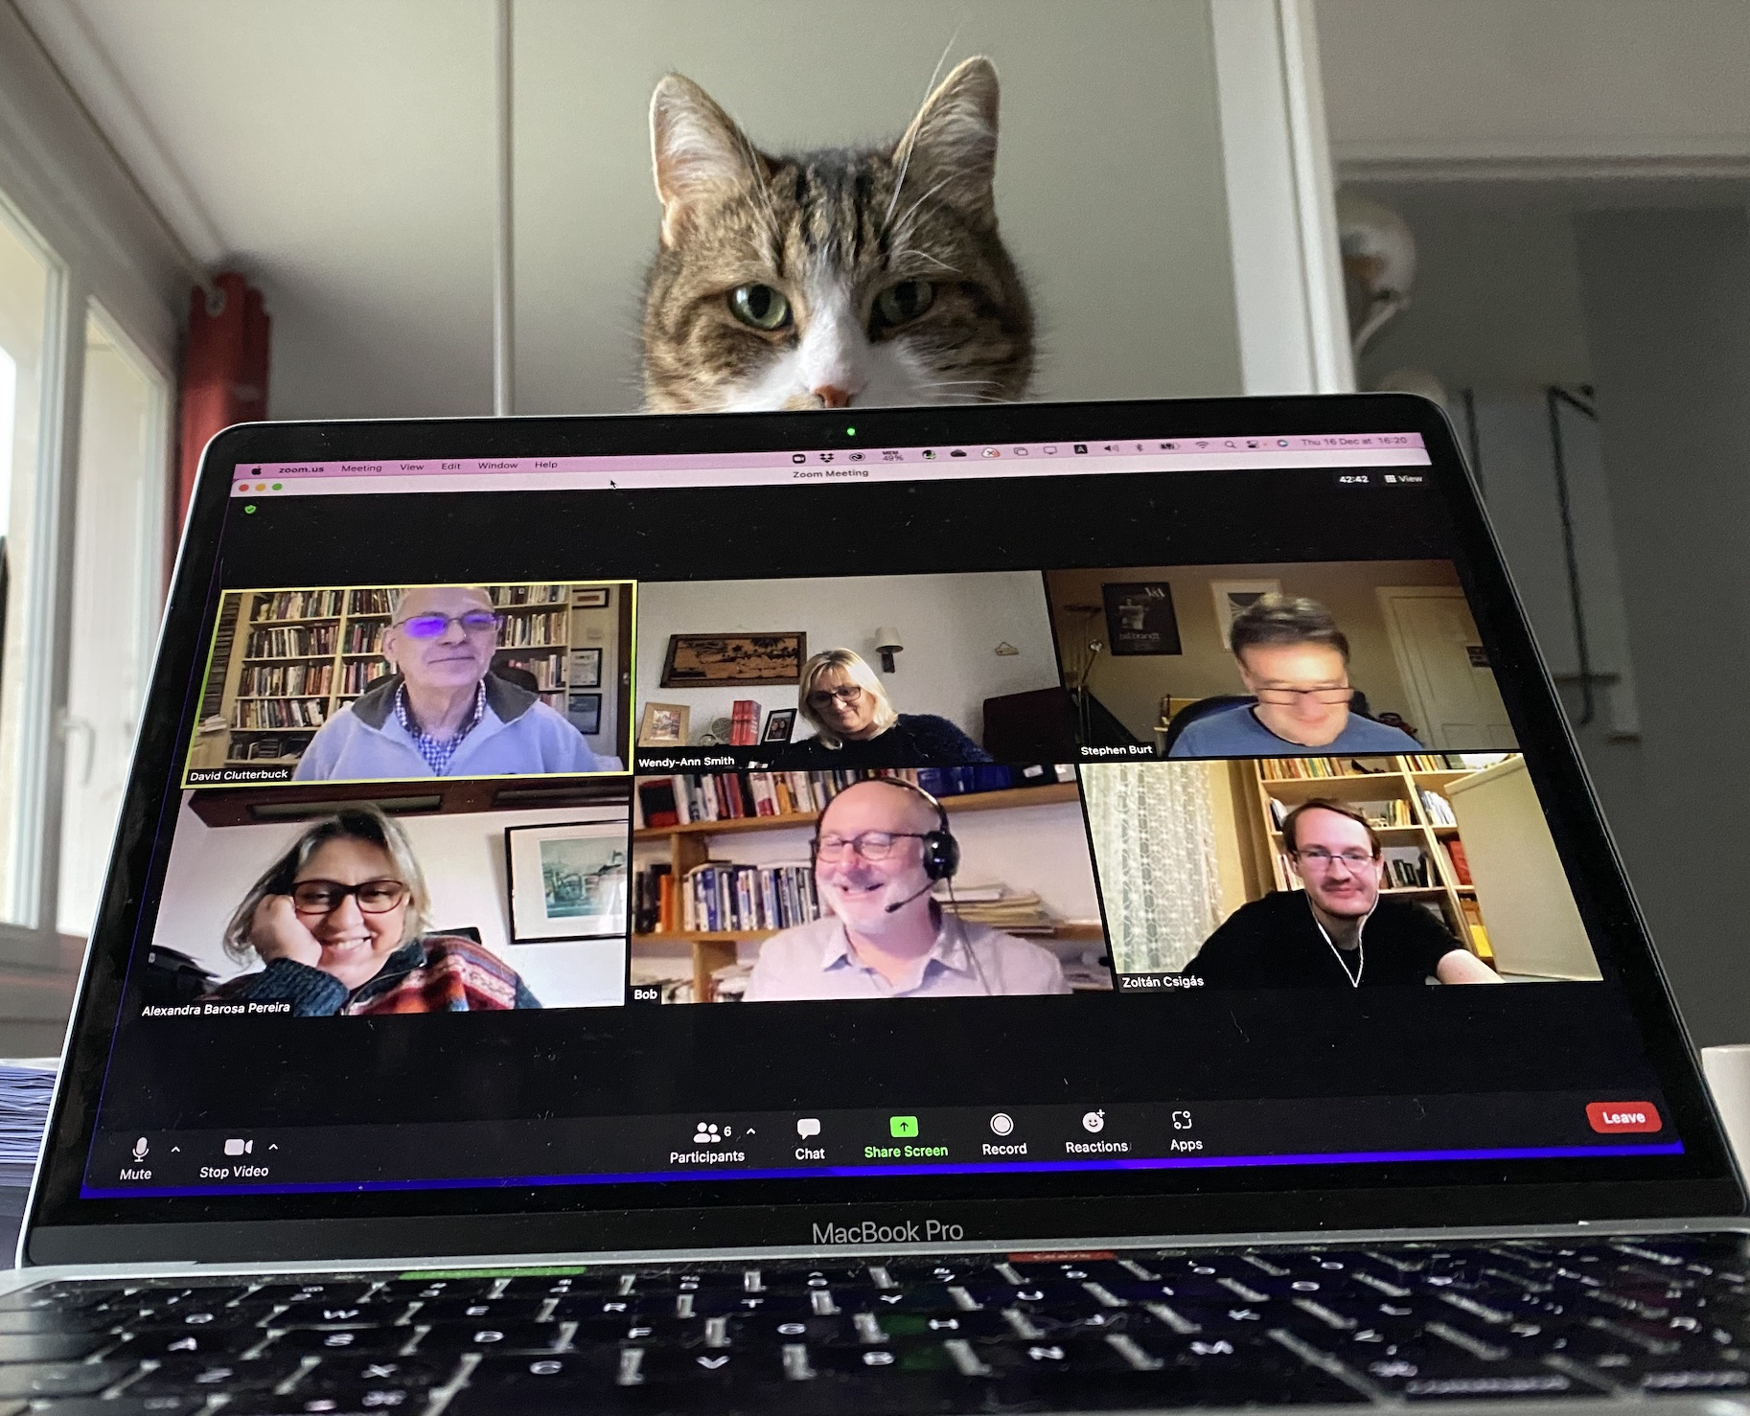
The Becoming of a Coach: Narratives of Learning and Development
Rajasinghe, D., Garvey, B., Smith, W-A., Burt, S., Barosa-Pereira, A., Clutterbuck, D. & Zoltán, C., Griffin, E.

Slide 2
Contents
Introduction
Context
Literature
Methodology
Findings
Practical and Theoretical Implications
Conclusion

Slide 3
Introduction
The starting point - Clutterbuck and Megginson (2011) ‘coach maturity’
How experienced coaches interpret their own development process
Little has been published
Methodology – Interpretative Phenomenological analysis (IPA)

Slide 4
Context - Literature
Emphasis placed on coachee development (Garvey, 2017; Bachkirova and Lawton-Smith, 2015)
Little published on coach development; most common approach is competency based (Garvey, 2017)
Coaching competence frameworks for coaches based on ‘stages of development’ (Garvey, 2017)
These ‘objectify’ learning and minimise the social and subjective nature learning and development (Rajasinghe and Allen, 2020)
Bachkirova and Lawton Smith (2015) policy makers appear to ‘lack interest’ (p.124) in alternative approaches to competency frameworks.
Drake, (2011:143) - competency frameworks helpful in supporting novice coaches but more experienced coaches may ‘break’ or ‘transcend’ these
More research needed

Slide 5
Research Question
“How do experienced coaches interpret their development journey?”

Slide 6
Research Methodology
Our Interest was on
Individual Coaches
Experience of experienced Coaches – as a source of knowledge
How they Interpret their coaching experience
Interpretative Phenomenological Analysis
Idiography – interest on individual cases
Phenomenology – experience as a source of knowing
Hermeneutics – Theory of interpretation (smith et al., 2009)

Slide 7
Data Collection and Analysis
Sampling
Purposive sampling (Gray, 2014)
Invited 46 participants and 32 coaches accepted invitation
Data Collection Method
Semi-structured interviews
Data Analysis
Transcribed using Otter transcribing software
Informed by IPA data analysis guidance (Smith et al., 2009; Rajasinghe et al., 2021)

Slide 8
Data analysis and IPA philosophies
Data analysis is multiple level of analysis (individual cases by respecting idiographic commitments and then cross analysis)
Initially cross analysis resulted four key themes. These themes were then further analysed by paired researchers.
This step helped us to develop a deeper level of analysis
Usual IPA analysis is subjected to double hermeneutics (participants interpretations interpreted by the researcher). Our study innovated here due to multiple researcher involvement in sense-making
We continue to question our influences and made every possible effort to give priority to participant experiences

Slide 9
Findings
Five Key themes
Vehicles of Development
(intentionality, supervision, work on self, experience and practical stimulus, acquiring repertoire, teacher as learner, the coach in the coaching community)
Narratives of Awareness
(awareness in the moment, intuitive awareness, reflective awareness, awareness of boundaries, general and systemic awareness, self-understanding)
Narratives of Letting Go
(holding lightly, letting go of ego, letting go of agenda and identity)
Ethical Practice
(mainly about self-care and fitness to practice)
Narratives of Becoming a Coach
(presence and connectivity, emphasis on relationship, authenticity, becoming but never arriving)
Notes:
Check with Bob if I should expand these or just have this slide and discuss at the presentation

Slide 10
Coach Development
Learn by doing
Learning emergent
Experience of the relationships - learning from clients
Reflection and reflexivity
Tolerate tensions and reflect on them
Self-development important
Notes:
I should discuss this with Bob to understand how to position our arguments here.

Slide 11
Conclusion
Maturity not a destination, not staged not an arrival
Continuous process of ongoing development – many variations
Development is messy
Experienced coach always in a state of becoming

Slide 12
Practical and Theoretical Implications
Competencies let go or held lightly
Serendipitous learning some formal some informal
Staged learning not serve needs
Ethics - more research is needed

Slide 13
Thank you!

Slide 14
References
Atad, O., WA. Smith, and S. Green 2021. Coaching as the Missing Ingredient in the Application and Training of Positive Psychological Science. In Positive Psychology Coaching in the Workplace, edited by Smith, WA., I. Boniwell, S. Green (41- 60). Springer. Cham. doi: https://doi.org/10.1007/978-3-030-79952-6_3
Bachkirova, T. and C. Kauffman. 2008. “Many ways of knowing: How to make sense of different research perspectives in studies of coaching.” Coaching: an international journal of theory, research and practice. 1(2): 107-113.
Bachkirova, T. and C. Lawton-Smith. 2015. “From competencies to capabilities in the assessment and accreditation of coaches.” International Journal of Evidence Based Coaching & Mentoring, 13(2): 123–140.
Brocki, J. M. and A.J. Wearden. 2006. “A critical evaluation of the use of interpretative phenomenological analysis (IPA) in health psychology.” Psychology and Health. 21(1): 87-108
Bond, T. 2013. Foreword, in Carroll, M., & Shaw, E. Ethical maturity in the helping professions: Making difficult life and work decisions. London. Jessica Kingsley Publishers.
Clutterbuck, D. and D. Megginson. 2011. Coach Maturity: An emerging concept https://coachingsupervisionacademy.com/mt-content/uploads/2019/11/clutterbuck_coaching_maturity.pdf
Corrie, S. and L. Kovacs. 2022. “Addressing the self-care needs of coaches through the use of formulation.” Coaching: An International Journal of Theory, Research and Practice. 15(1): 117-130,
Campone, F. and D. Awal, D. 2012. “Life’s thumbprint: the impact of significant life events on coaches and their coaching.” Coaching: An International Journal of Theory, Research and Practice, 5(1): 22-36
de Estevan-Ubeda, N. 2018. “Development insights: the learning journeys of highly experienced coach supervisors.” International Journal of Evidence Based Coaching and Mentoring, S12: 123-137. doi: 10.24384/000537
De Haan, E. 2008. “I struggle and emerge: Critical moments of experienced coaches.” Consulting Psychology Journal: Practice and Research. 60(1): 106 -131.
De Haan, E. and J. Gannon, J.2017. The coaching relationship. In The SAGE handbook of coaching edited by Bachkirova, T., G. Spence, and D. Drake (195- 217), London. Sage Publications Ltd
Dewey, J. 1896. “The Reflex Arc Concept of Psychology.” Psychological Review. 3(4):357-370
Drake, D.2011. “What do coaches need to know? Using the Mastery Window to assess and develop expertise.” Coaching: An International Journal of Theory, Research and Practice. 4(2): 38-155
Garvey, B. 2017. Issues of assessment and accreditation of coaches. In The SAGE handbook of coaching, edited by Bachkirova, T., G. Spence, and D. Drake. (680–695). London: SAGE Publications Ltd
Garvey, R. 2011. A very short, fairly interesting, and reasonably cheap book about coaching and mentoring. London. Sage Publication Ltd.
Gray, D. E. (2014). Doing research in the real world. 3rd ed. London: Sage Publication Ltd.
Hawkins, P. and N. Smith. 2006. Coaching, Mentoring and Organisational Consultancy: Supervision and Development. Maidenhead. Open University Press.
Harrison, R. and R. Smith. 2001. Practical judgment: its implications for knowledge development and strategic capability. In B. Hellgren and J. Lowstedt (eds). Management in the Thought-Full Enterprise – European Ideas on Organizing. Poland. OZGraf SA: Fagbokforlaget.

Slide 15
References
Hodge, A. 2016. “The value of coaching supervision as a development process: Contribution to continued professional and personal wellbeing for executive coaches.” International Journal of Evidence Based Coaching and Mentoring. 14 (2) :87-106
Huggin, K. S., H. W. Klar, and P. M Andreoli. 2021. “I thought I was prepared to do this”: an exploration of the learning and development of leadership coaches.” International Journal of Mentoring and Coaching in Education. 10 (4): 486-500
Hurlow, S. 2022. “Revisiting the Relationship between Executive Coaching and Learning: The Problems and Possibilities.” Academy of Management Learning & Education. 21 (1): 121-138
Jarvis, P. 1992. Paradoxes of Learning - on becoming an individual in society. San Francisco. Jossey Bass Higher Education Series
Lane, D.A. 2017. Trends in Development of Coaches (Education and Training): Is it Valid, Is it Rigorous and Is it Relevant? In The SAGE Handbook of Coaching, edited by Bachkirova, T., G. Spence, & D. B. Drake (647-661). London. SAGE Publications Ltd
Lincoln, Y.S. and E.G. Guba. 1985. Naturalistic Inquiry. California: Sage Publications Inc.
Nicholson, H. and B. Carroll. 2013. “Identity undoing and power relations in leadership development.” Human relations, 66(9): 1225-1248.
Oishi, S., H. Choi, M. Koo, I. Galinha, K.Ishii, A. Komiya, M. Luhmann, C. Scollon, J.E, Shin, H. Lee, E.M. 2020. “Happiness, Meaning, and Psychological Richness”. Affective Science 1(2): 107–115.
Passmore, J. and O. Marianetti. 2007. “The role of mindfulness in coaching.” The Coaching Psychologist. 3(3): 131-137
Rajasinghe, D., C. Aluthgama-Baduge and G. Mulholland, G. 2021. "Researching entrepreneurship: an approach to develop subjective understanding." International Journal of Entrepreneurial Behavior & Research. 27(4): 866-883. doi: https://doi.org/10.1108/IJEBR-10-2019-0601
Rajasinghe, D. 2020. Interpretative phenomenological analysis (IPA) as a coaching research methodology. Coaching: An International Journal of Theory, Research and Practice, 13(2): 176-190.
Rajasinghe D., C. Allen C. 2020. Coaching for Workplace Learning and Development. In The Future of HRD, Volume II, edited by: Loon M., J.Stewart, S. Nachmias (147-175). Palgrave Macmillan, Cham. doi: https://doi.org/10.1007/978-3-030-52459-3_6
Rogers, C.R. 1954. Toward a theory of creativity. ETC: A review of general semantics, pp.249-260.
Schon, D. A. 1983. The Reflective Practitioner: How Professionals Think in Action. New York. Basic Books.
Smith, J.A., P. Flowers and M. Larkin. 2009. Interpretative phenomenological analysis: theory, methods and research. London: Sage Publications Ltd
Ting-Toomey, S.1999. Communicating Across Cultures. New York. The Guilford Press.
Wagstaff. C., H. Jeong, M. Nolan, T. Wilson, J. Tweedlie, P.E.H. Senu and F. Holland 2014. “The accordion and the deep owl of spaghetti: eight researchers’ experiences of using IPA as a methodology.” The Qualitative Report. 19(47): 1-15.
Wagstaff, C. and Williams, B. 2014. “Specific design features of an interpretative phenomenological analysis study.” Nursing Research. 21 (3): 8-12.
Western, S. 2012. Coaching and mentoring: A critical text. London. Sage Publication Ltd
Willig, C.2014. Interpretation and analysis. In Sage handbook of qualitative data analysis, edited by Flick, U. (136–149). London: Sage Publication Ltd.

